Slide 1







Anvisys Technology Pvt. Ltd
your Trusted IT solution and consulting partner
Complete IT support
Latest technology
Problem solving solutions
Timely completion of projects
Notes:
Anvisys Technology
www.Anvisys.net contact us.

Slide 2
Our Mission
We aim to be the most preferred IT partner to our clients by helping the achieve their goals
We focus on our client’s goal. Keeping up with the latest technology used to provide support to our clients.
Anvisys is all about providing a platform to our team members to learn and be more efficient to serve the diverse needs of our clients

Slide 3
Problem Solving Solution
Working on abundance of data maintenance & analyzing it in an orderly manner through various digital tools.
Upgrade & Maintenance
Technical Support
A good I.T infrastructure to solve various problems like database management, coding, developing & testing to transform your day to day manual operations to a digitalized way.
Efficient backend support in order to ensure smooth running of process
THINK
BIGGER
Steady Growth
Working in integration with all the levels of your business in order to achieve organizational goals by

Slide 4
WE AIM TO MAINTAIN A LONG TERM RELATION WITH OUR CLIENTS BY PROVIDING A RANGE OF SERVICES.
Staffing – Software Professionals
End to End Software Solutions
Android , Desktop, Web, DB
Services
Geographical Information System(GIS
Software Testing
Anvisys technology Pvt. Ltd
Notes:
Types of services we offer

Slide 5
Xml for UI, Core Java for Business Logic, API or services to read/write data Android Studio : Native Android Development tool
Android Application
1
Html CSS Java Script
Web Application
2
Word press Angular JS
Angular 4.0
ASP.net
Desktop Application
3
MYSQL
Mongo DB
SQLServer
Database Designing
4
Notes:
What we do ?

Slide 6
Result web service
Small size solutions of team of 5 to 10 resources:
Android Application
Web Application
Database Designing
Microservices and Service
Non Functional
Architecture: Monolithic, Service Oriented Architecture,
Microservice Architecture
Security: Database level, OAuth, SSL, Cloud Security
Methodology : Agile, Waterfall, iterative
Web service
Client
HTTP request
JSON/XML
Device
Web Apps Desktop
Database

Slide 7
Software Solutions we Offer
2
1
Desktop Application
Android Application
4
Web Application
3
Database Designing

Slide 8

We area of expertise
jQuery is a JavaScript library designed to simplify HTML DOM tree traversal and manipulation, as well as event handling, CSS animation, and Ajax.
Windows Presentation Foundation (WPF) is a graphical subsystem by Microsoft for rendering user interfaces in Windows-based applications
AngularJS is a JavaScript-based open-source front-end web framework mainly maintained by Google and by a community of individuals and corporations to address many of the challenges encountered in developing single-page applications
Support area’s
.NET is a developer platform made up of tools, programming languages, and libraries for building many different types of applications.
Android development for mobile application building
Word Press is a free and open-source content management system based on PHP & MySQL. Features include a plug-in architecture and a template system.
Project Management Professional is an internationally recognized professional designation offered by the Project Management Institute

Slide 9
Our Clients
Egis India.
Pinnacle Geo-system
Dr. Sundeep Goyal
BHEL, Haridwar
Advisory On Demand
Nestin
Anvisys technology Pvt. Ltd

Slide 10


PRODUCT 3
PRODUCT 2
NESTIN
PRODUCT 2
X- PEN
PRODUCT 1
PRODUCT 1
Let’s Catch-up
Society Management System
Car pooling
Easy Payment of Bills
Upgraded Security for society
Vendor management
Salary, Capex and other transaction by Accounts
Expense and Accounting Management for personal and organization needs
Projects Sale, purchase entries by Project Manager
3
Our products
Share your location with your friends
Receive location shared by your friends
Get the Route, Location and Time Difference
Share your location with your friends
Receive location shared by your friends
2
1

Slide 11

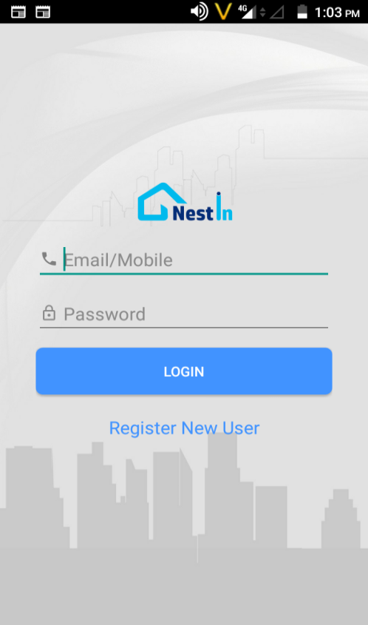
A Complete Society Management System

Slide 12
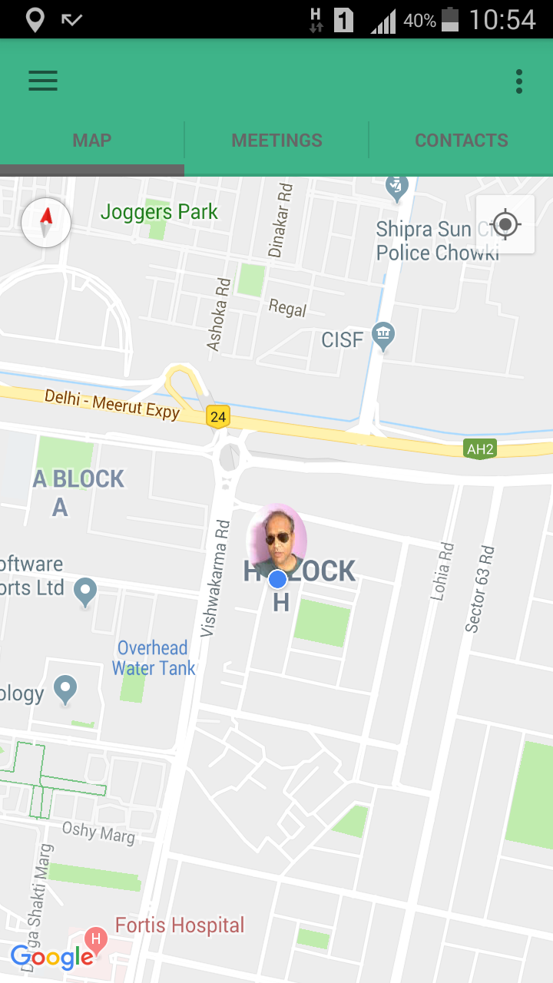
Let’s Catch-up
Share your location with your friends
Receive location shared by your friends
.
Get the Route, Location and Time Difference
Notes:
Now track your close ones by Let’s catch-up. With live tracking and location sharing .

Slide 13
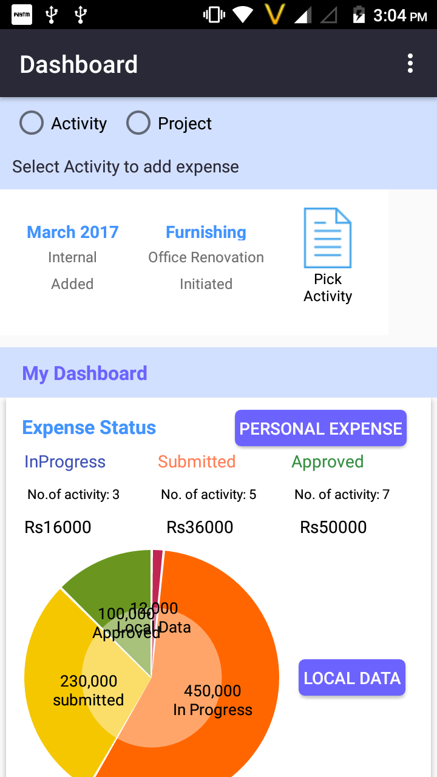
+150%
X- PEN
17,9871
9,9871
+120%
Expense and Accounting Management for personal and organization needs
+110%
5,9871
-50%
3,9871
7,9871
-30%
Projects Sale, purchase entries by Project Manager
Salary, Capex and other transaction by Accounts

